Slide 1

Principles of Macroeconomics 3e
Chapter 12 THE KEYNESIAN PERSPECTIVE
PowerPoint Image Slideshow

Slide 2
Ch.12 OUTLINE
12.1: Aggregate Demand in Keynesian Analysis
12.2: The Building Blocks of Keynesian Analysis
12.3: The Phillips Curve
12.4: The Keynesian Perspective on Market Forces

Slide 3
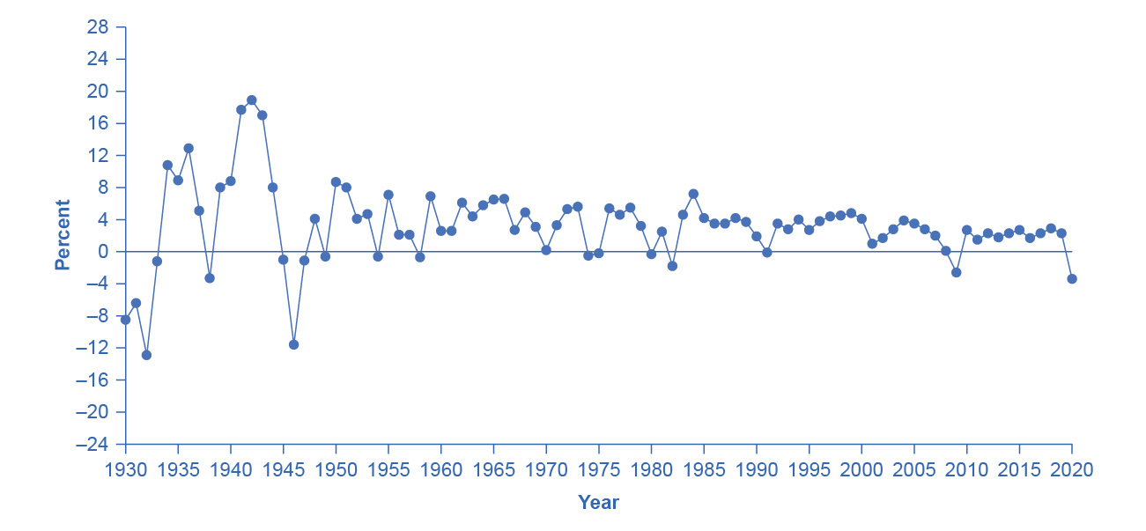
U.S. Real Domestic Product, Percent Changes 1930–2020
The chart tracks the percent change in Real GDP since 1930.
The magnitude of both recessions and peaks was quite large between 1930 and 1945. (Source: Bureau of Economic Analysis, “National Economic Accounts," https://apps.bea.gov/itable/index.cfm)

Slide 4
12.1 Aggregate Demand in Keynesian Analysis
The Keynesian perspective focuses on the idea that firms produce output only if they expect it to sell.
Real GDP - the amount of goods and services actually sold in a nation.
Keynes argued that aggregate demand is not stable - that it can change unexpectedly.
Recessionary gap - equilibrium at a level of output below potential GDP.
Inflationary gap - equilibrium at a level of output above potential GDP.

Slide 5
What Determines Consumption Expenditure?
Consumption expenditure is spending by households and individuals on durable goods, nondurable goods, and services.
Keynes identified three factors that affect consumption:
Disposable income - income after taxes.
Expected future income
Wealth or credit

Slide 6
What Determines Investment Expenditure?
Spending on new capital goods is called investment expenditure.
These fall into four categories:
producer’s durable equipment and software
nonresidential structures (such as factories, offices, and retail locations)
changes in inventories
residential structures (such as single-family homes, townhouses, and apartment buildings)
When a business decides to make an investment in physical or intangible assets, the firm considers both:
the expected investment benefits (future profit expectations)
the investment costs (interest rates)

Slide 7
What Determines Government Spending?
Federal, state, and local government spending provides important public services such as national defense, transportation infrastructure, and education.
Keynes recognized that the government budget offered a powerful tool for influencing aggregate demand.
More government spending could stimulate AD (or less government spending reduce it).
Lowering or raising tax rates could influence consumption and investment spending.
Keynes concluded that during extreme times like deep recessions, only the government had the power and resources to move aggregate demand.

Slide 8
What Determines Net Exports?
Since we define aggregate demand as spending on domestic goods and services, export expenditures add to AD, while import expenditures subtract from AD.
Two sets of factors can cause shifts in export and import demand:
changes in relative growth rates between countries
changes in relative prices between countries

Slide 9
12.2 The Building Blocks of Keynesian Analysis
Keynesian economics focuses on explaining why recessions and depressions occur and offering a policy prescription for minimizing their effects.
The Keynesian view of recession is based on two key building blocks.
Aggregate demand is not always automatically high enough to provide firms with an incentive to hire enough workers to reach full employment.
The macroeconomy may adjust only slowly to shifts in aggregate demand because of sticky wages and prices.
Sticky wages and prices - a situation where wages and prices do not fall in response to a decrease in demand, or do not rise in response to an increase in demand.

Slide 10
Wage and Price Stickiness, Continued
Menu costs - costs firms face in changing prices.
changing prices uses company resources
frequent price changes may leave customers confused or angry

Slide 11
The Expenditure Multiplier
Expenditure multiplier - Keynesian concept that asserts that a change in autonomous spending causes a more than proportionate change in real GDP.
The idea that not only does spending affect the equilibrium level of GDP, but that spending is powerful.
The reason for the expenditure multiplier is that one person’s spending becomes another person’s income, which leads to additional spending and additional income
The cumulative impact on GDP is larger than the initial increase in spending.

Slide 12
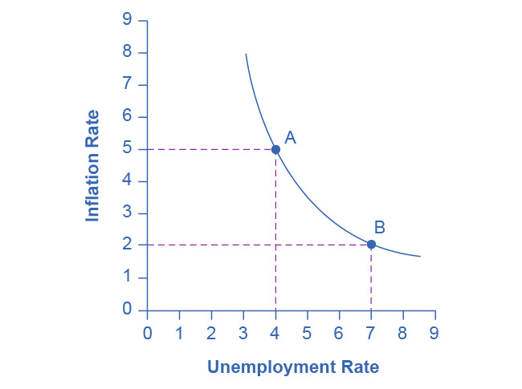
A Keynesian Phillips Curve Tradeoff between Unemployment and Inflation
A Phillips curve illustrates a tradeoff between the unemployment rate and the inflation rate.
If one is higher, the other must be lower.
For example, point A illustrates a 5% inflation rate and a 4% unemployment.
If the government attempts to reduce inflation to 2%, then it will experience a rise in unemployment to 7%, as point B shows.

Slide 13
Keynesian Policy for Fighting Unemployment and Inflation
Keynesian macroeconomics argues that the solution to a recession is expansionary fiscal policy.
Expansionary fiscal policy - tax cuts or increases in government spending designed to stimulate aggregate demand and move the economy out of recession.
When the economy is operating above potential GDP, unemployment is low, but inflationary rises in the price level are a concern.
The Keynesian response would be contractionary fiscal policy, using tax increases or government spending cuts to shift AD to the left.
The result would be downward pressure on the price level, but very little reduction in output or very little rise in unemployment.
Contractionary fiscal policy - tax increases or cuts in government spending designed to decrease aggregate demand and reduce inflationary pressures

Slide 14
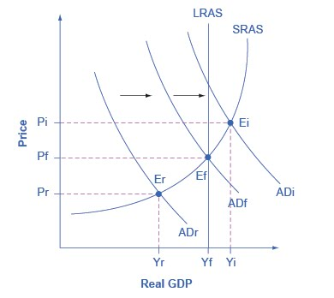
Fighting Recession and Inflation with Keynesian Policy
If an economy is in recession, with an equilibrium at E_{r}, then the Keynesian response would be to enact a policy to shift aggregate demand to the right from AD_{r} toward AD_{f}.
If an economy is experiencing inflationary pressures with an equilibrium at E_{i}, then the Keynesian response would be to enact a policy response to shift aggregate demand to the left, from AD_{i} toward AD_{f}.

Slide 15
12.4 The Keynesian Perspective on Market Forces
Controversy has simmered over the extent to which government should play an active role in managing the economy.
Some supporters of Keynesian economics advocated a high degree of government planning in all parts of the economy.
However, Keynes was careful to separate the issue of aggregate demand from the issue of how well individual markets worked.

Slide 16
The Keynesian Perspective on Market Forces, Continued
He argued that individual markets for goods and services were appropriate and useful, but that sometimes that level of aggregate demand was just too low.
He also believed that, while government should ensure that overall level of aggregate demand is sufficient for an economy to reach full employment, this task did not imply that the government should attempt to set prices and wages, nor to take over and manage large corporations or entire industries directly.

